Slide 1
DG INTERNS HUB • SOC ANALYST INTERNSHIP
Week 1 - The Basics:
Security and the SOC
Weekly Work Report and Presentation
6 theoretical notes • 6 lab writeups • 4 hands-on event captures • Windows lab on DESKTOP-QKP3UOG
07 October 2026

Slide 2
Agenda
What this presentation covers
• Part 1 - Theoretical notes (6 topics)
• Part 2 - Lab writeups (6 labs)
• Part 3 - Hands-on Windows Event Viewer lab
• Part 4 - Findings, analysis and takeaways
• Deliverables and LinkedIn activity
Week 1 at a glance
Notes: 6 documents / 19 pages
Writeups: 6 documents / 75 pages
Labs: 5 TryHackMe + 1 LetsDefend
Screenshots: 4 Event Viewer captures
Event IDs: 4624, 4625, 4688, 4720
DG Interns Hub | Week 1 - The Basics: Security and the SOC
2

Slide 3
Week 1 at a Glance
Theory, practice and hands-on work
PART 1
Theoretical Notes
PART 2
Lab Writeups
PART 3
Hands-On Lab
• What is a SOC?
• Analyst levels L1/L2/L3
• The CIA Triad
• TCP/IP vs OSI
• Phishing
• Malware case study
• TryHackMe x 5 rooms
• LetsDefend x 1 course
• Every task answered
• OSI, TCP/IP, tools
• Cyber Kill Chain
• Windows Fundamentals
• VirtualBox lab built
• Windows 10 + Linux VMs
• Event Viewer on Windows
• 4624 / 4625 captured
• 4688 / 4720 captured
• Timeline correlated
DG Interns Hub | Week 1 - The Basics: Security and the SOC
3

Slide 4
PART 1
Theoretical Notes
Six topics written up in my own words, using bullet points and tables
DG Interns Hub | Week 1 - The Basics: Security and the SOC
4

Slide 5
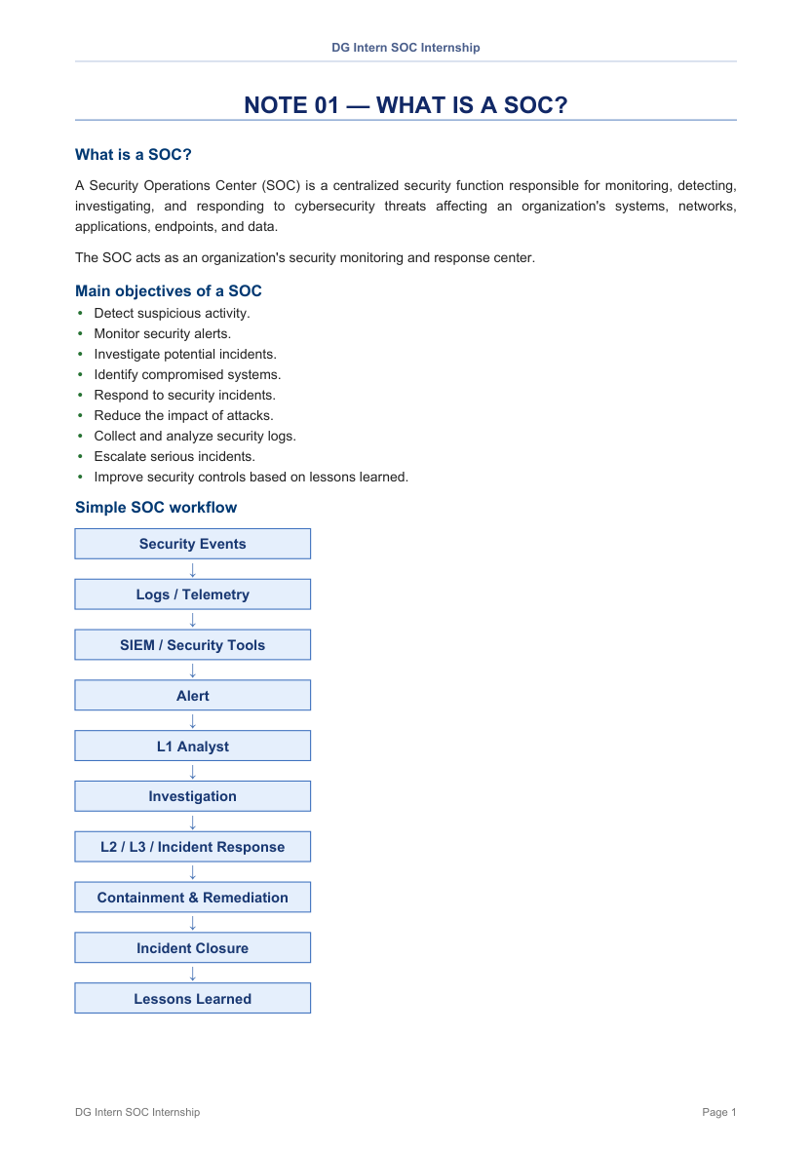
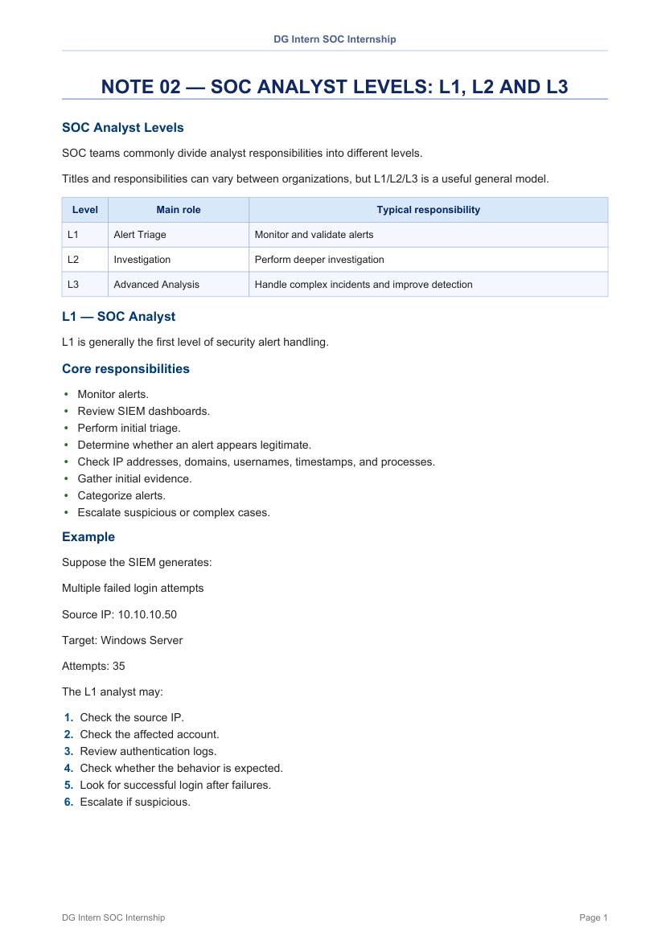
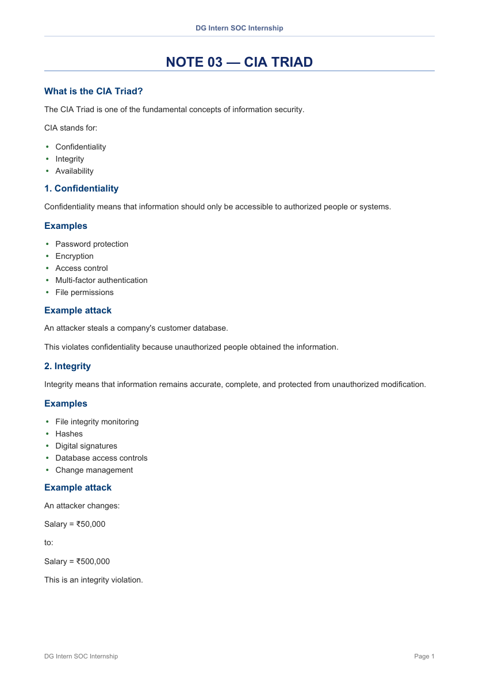
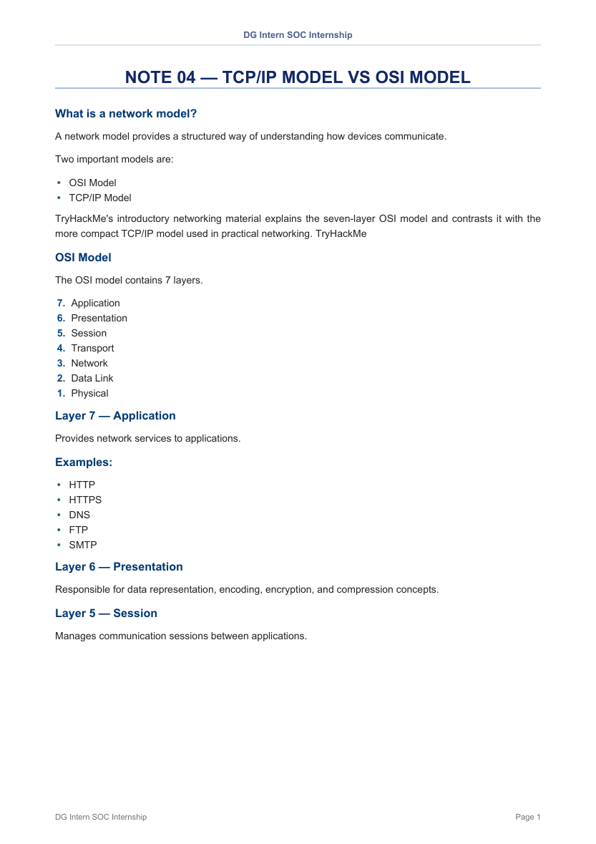
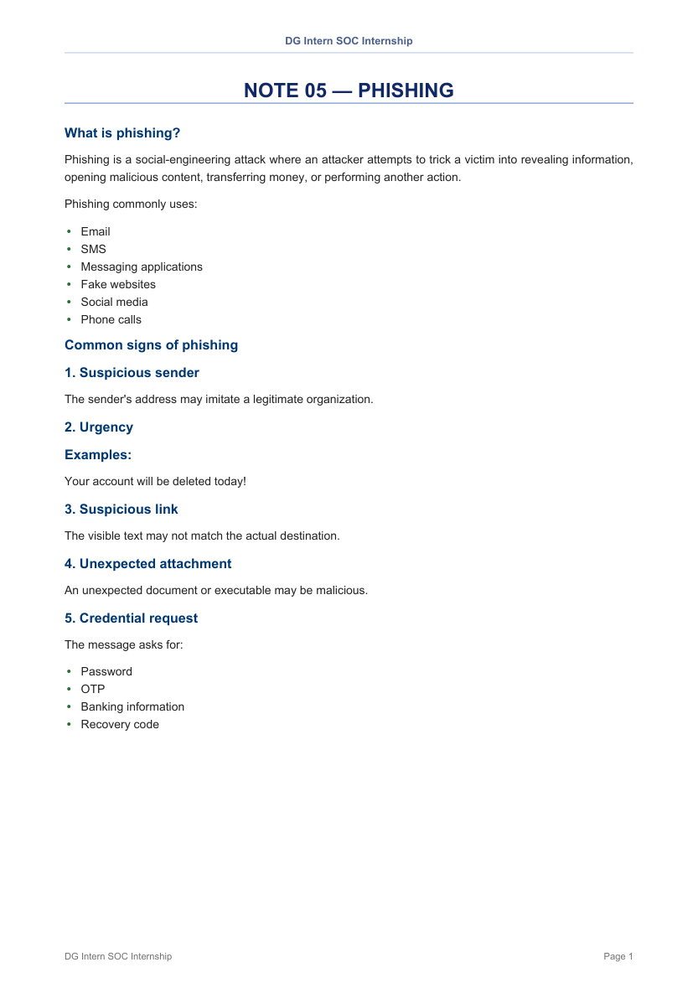
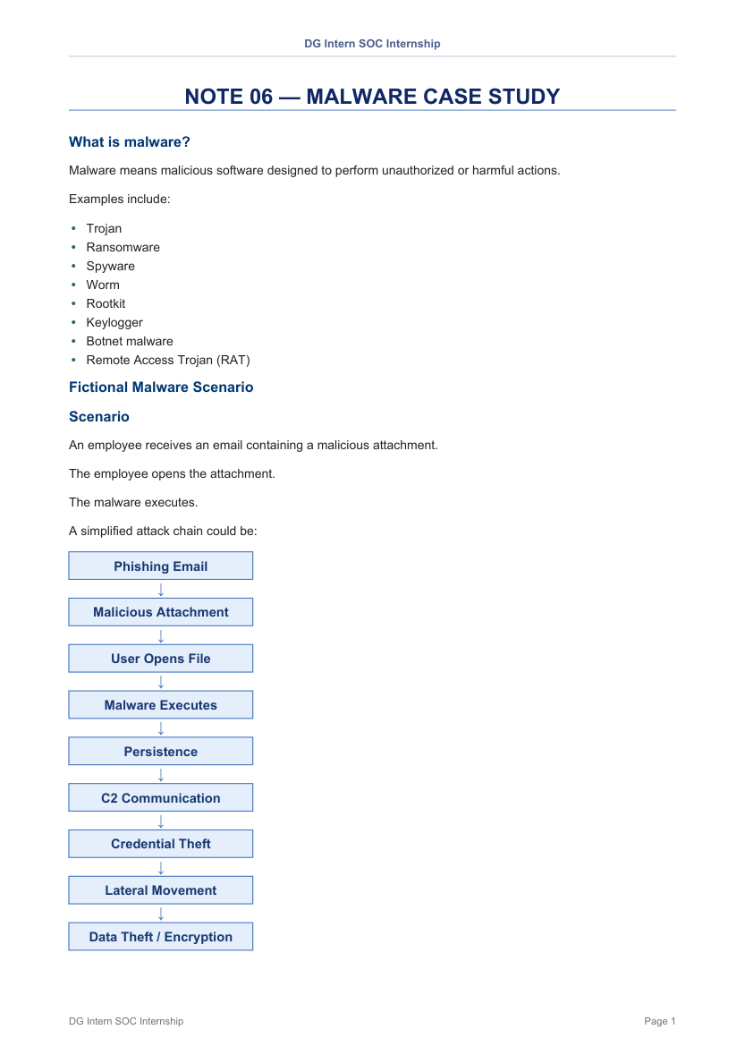
Theoretical Notes - Overview
One document per question, as required by the brief
NOTE 01
What is a SOC?
NOTE 02
SOC Analyst Levels L1/L2/L3
NOTE 03
The CIA Triad
NOTE 04
TCP/IP vs OSI Model
NOTE 05
Phishing
NOTE 06
Malware Case Study
DG Interns Hub | Week 1 - The Basics: Security and the SOC
5

Slide 6
What is a SOC?
Note 01 - the Security Operations Center
A centralized security function that monitors, detects, investigates and responds to cyber threats across systems, networks, applications, endpoints and data.
Main objectives
• Detect suspicious activity and monitor alerts
• Investigate potential incidents and confirm compromise
• Respond to incidents and reduce attack impact
• Collect and analyse security logs
• Escalate serious incidents and improve controls
SOC workflow
• Security events
• Logs / telemetry
• SIEM / security tools
• Alert
• L1 analyst triage
• Investigation (L2 / L3)
• Containment and remediation
• Closure and lessons learned
DG Interns Hub | Week 1 - The Basics: Security and the SOC
6

Slide 7
SOC Technology Stack
Note 01 - tools and what a SOC monitors
Technology | Purpose | Examples
SIEM | Collects and correlates logs from many sources | Splunk, Sentinel, Elastic, QRadar
EDR | Monitors endpoint activity and suspicious processes | Endpoint agents
SOAR | Automates repetitive tasks and response workflows | Playbooks and automation
Threat Intel | Provides known-bad IPs, domains, hashes | Feeds and enrichment
What a SOC monitors
Endpoints • Network (firewalls, routers, IDS/IPS) • Applications and APIs • Identity and authentication • Cloud • Email • Servers • Security tools • Threat intelligence
DG Interns Hub | Week 1 - The Basics: Security and the SOC
7

Slide 8
SOC Analyst Levels: L1, L2 and L3
Note 02 - how SOC work is tiered
Level | Main role | Core responsibilities
L1 | Alert triage | Monitor alerts and SIEM dashboards, initial triage, check IPs, domains, users, gather evidence, categorise, escalate
L2 | Investigation | Investigate escalated alerts, correlate logs, analyse endpoint and network activity, scope impact, recommend containment
L3 | Advanced analysis | Threat hunting, complex incident response, malware analysis, detection engineering, advanced forensics
The tiers work as a chain
L1 triage → L2 investigation → L3 / specialist advanced analysis and response
L1 analysts triage alerts and pass complex cases up; L2 investigate more advanced attacks; L3 and specialists handle the deepest security functions.
DG Interns Hub | Week 1 - The Basics: Security and the SOC
8

Slide 9
The CIA Triad
Note 03 - the three pillars of information security
Principle | Meaning | Example control | Example attack
Confidentiality | Prevent unauthorized access | Encryption, MFA, permissions | Stolen customer database
Integrity | Prevent unauthorized modification | Hashes, signatures, FIM | Tampered salary record
Availability | Keep services accessible | Backups, redundancy, DDoS protection | DDoS attack on a web server
Applied to real life: online banking
• Confidentiality - only the account owner sees account information
• Integrity - a user cannot alter their balance without authorization
• Availability - the banking app stays reachable when customers need it
DG Interns Hub | Week 1 - The Basics: Security and the SOC
9

Slide 10
TCP/IP Model vs OSI Model
Note 04 - how computers talk to each other
OSI | TCP/IP
7 layers | 4 layers
Conceptual / reference model | Practical networking model
Developed by ISO | Developed around DoD / Internet protocols
Used for learning and troubleshooting | Widely used in real networking
Layer mapping
• Application + Presentation + Session → Application
• Transport → Transport
• Network → Internet
• Data Link + Physical → Network Access
OSI layers 7 to 1: Application, Presentation, Session, Transport, Network, Data Link, Physical. TCP is connection-oriented and reliable; UDP is connectionless with lower overhead.
DG Interns Hub | Week 1 - The Basics: Security and the SOC
10

Slide 11
Phishing
Note 05 - social engineering and the analyst response
Six warning signs
1. Suspicious sender address
2. Urgency (account will be deleted today)
3. Link text does not match destination
4. Unexpected attachment
5. Credential / OTP request
6. Unusual language or formatting
How a user should respond
• Never click suspicious links
• Verify the sender independently
• Navigate to the official site manually
• Contact IT through a trusted channel
• Report the message
• Never share passwords or OTPs
A safe fictional training email was written for the Phishing note - clearly marked as a simulation with no real credentials.
DG Interns Hub | Week 1 - The Basics: Security and the SOC
11

Slide 12
Malware Case Study
Note 06 - a fictional scenario from infection to response
Attack chain
• Phishing email → malicious attachment
• User opens the file → malware executes
• Persistence established
• Command and control communication
• Credential theft → lateral movement
• Data theft or encryption (ransomware)
Response lifecycle
• Detect → Triage → Investigate → Confirm
• Contain → Eradicate → Recover → Document
• Detection sources: email logs, EDR process chains, DNS logs, firewall/proxy logs, authentication logs, SIEM correlation
DG Interns Hub | Week 1 - The Basics: Security and the SOC
12

Slide 13
PART 2
Lab Writeups
Five TryHackMe rooms and the LetsDefend SOC Fundamentals course, fully documented
DG Interns Hub | Week 1 - The Basics: Security and the SOC
13

Slide 14
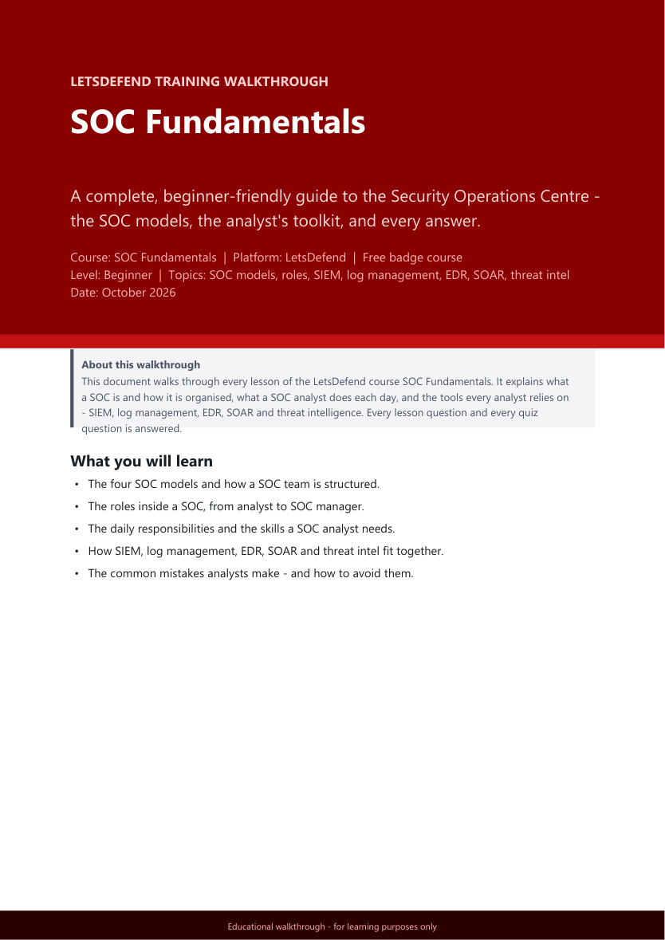
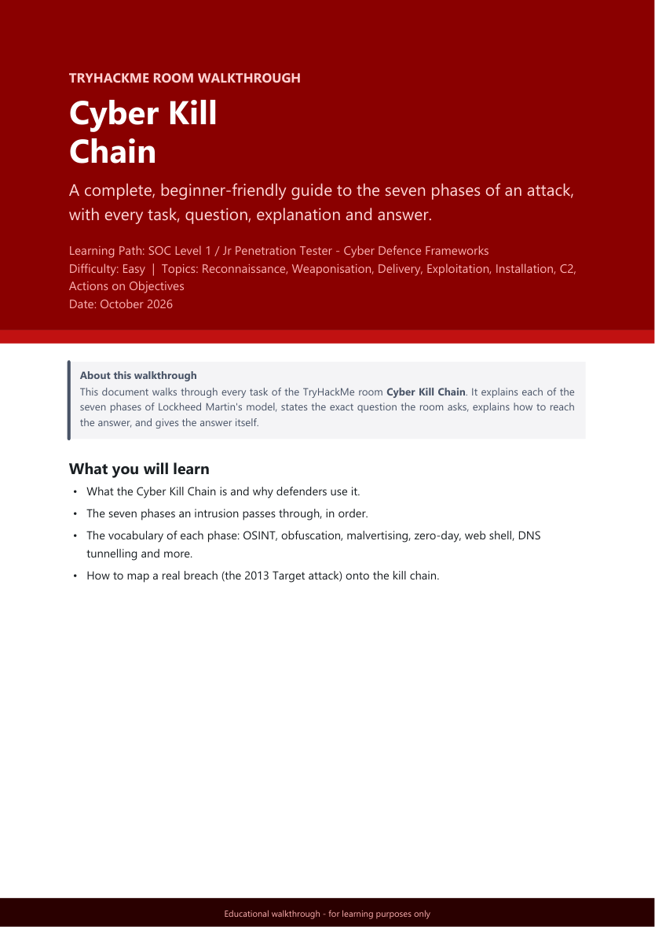
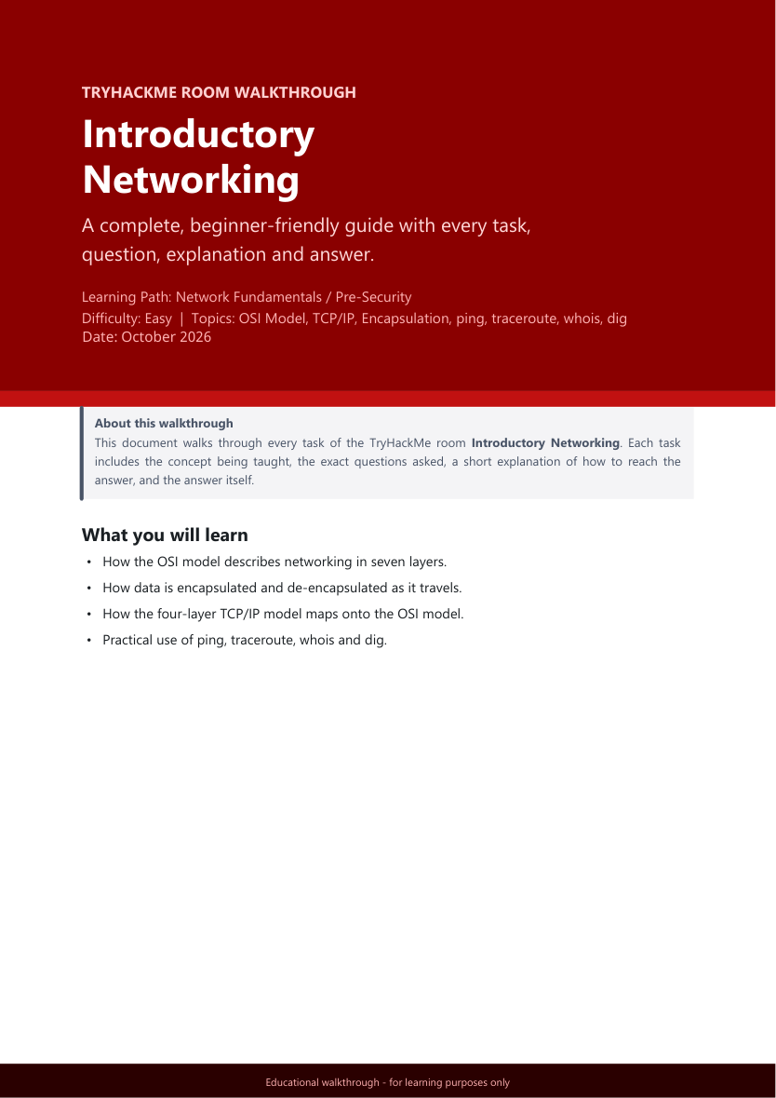
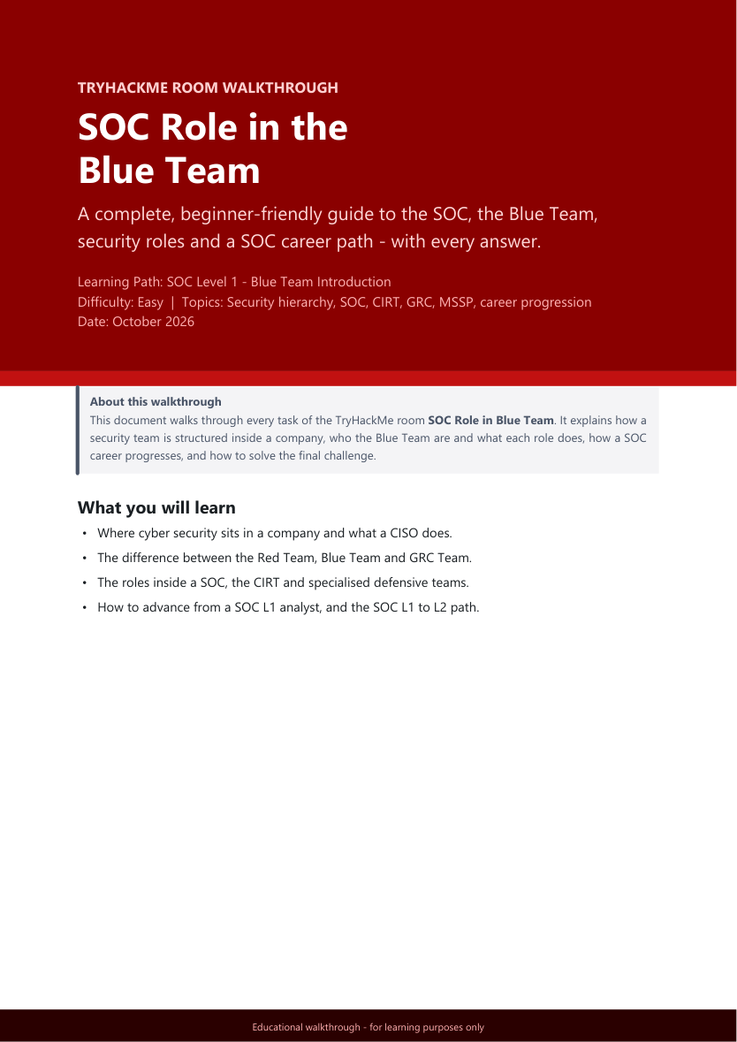
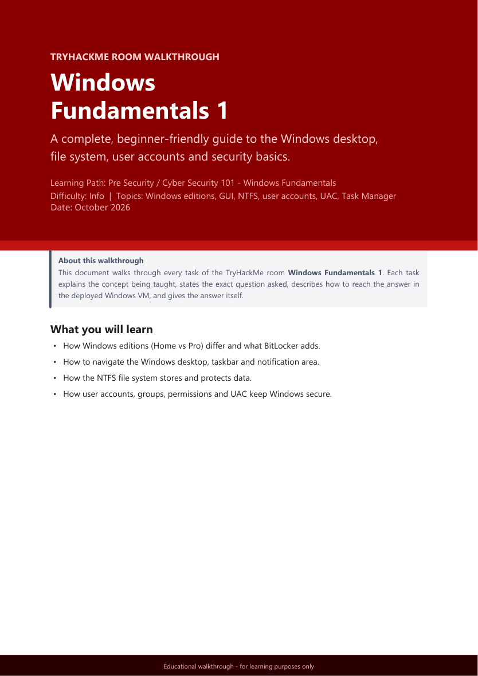
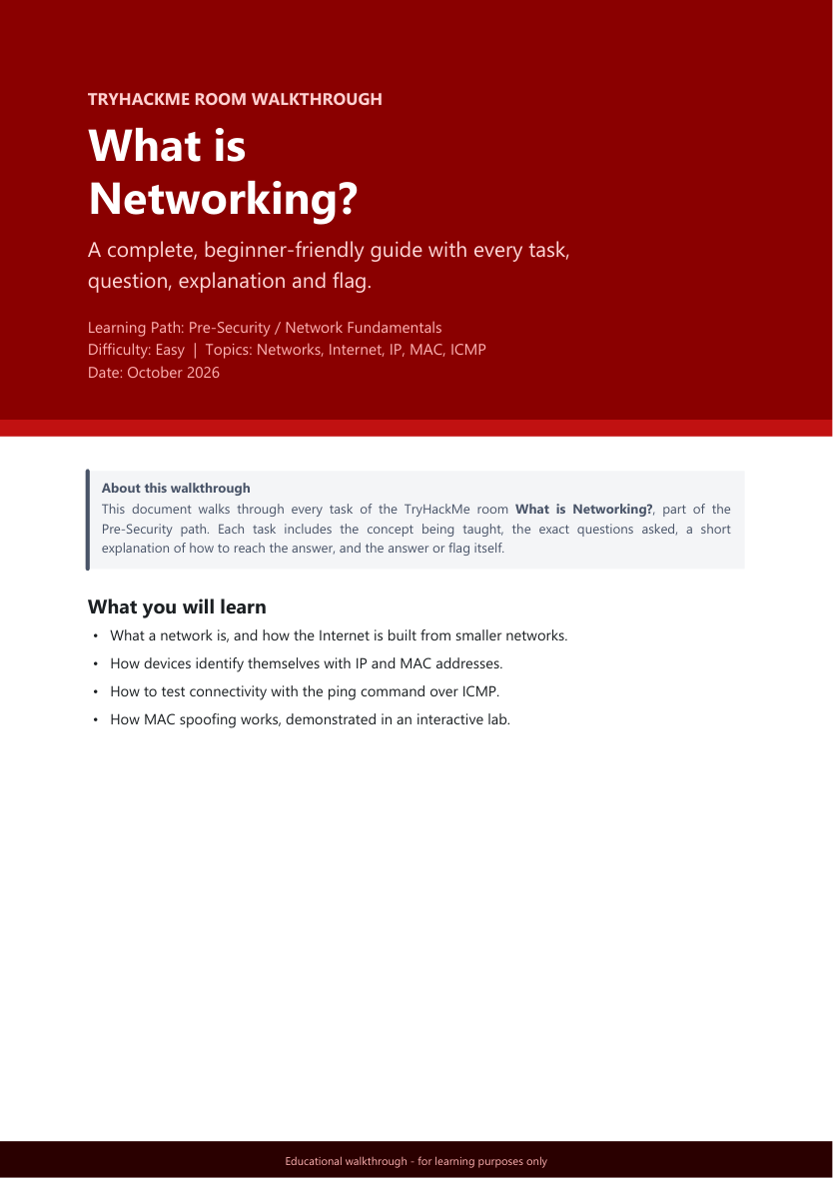
Lab Writeups - Overview
One writeup per lab, with every task, question and answer
LetsDefend
SOC Fundamentals
TryHackMe
Cyber Kill Chain
TryHackMe
Introductory Networking
TryHackMe
SOC Role in Blue Team
TryHackMe
Windows Fundamentals 1
TryHackMe
What is Networking?
DG Interns Hub | Week 1 - The Basics: Security and the SOC
14

Slide 15
Labs Completed
Five TryHackMe rooms plus one LetsDefend course
Lab / Course | Platform | Length | Type
SOC Fundamentals | LetsDefend | 14 pages | SOC Analyst Learning Path
Cyber Kill Chain | TryHackMe | 13 pages | SOC Level 1 - Cyber Defence Frameworks
Introductory Networking | TryHackMe | 17 pages | Network Fundamentals
SOC Role in the Blue Team | TryHackMe | 9 pages | SOC Level 1 - Blue Team Intro
Windows Fundamentals 1 | TryHackMe | 13 pages | Cyber Security 101 - Windows
What is Networking? | TryHackMe | 9 pages | Pre-Security - Network Fundamentals
Total: 75 pages of walkthroughs - every task, question, explanation and answer recorded.
DG Interns Hub | Week 1 - The Basics: Security and the SOC
15

Slide 16
LetsDefend - SOC Fundamentals
Free badge course | SOC Analyst Learning Path
Topics covered
• Introduction to SOC and the three pillars
• SOC types and roles
• SOC analyst responsibilities and skills
• SIEM and the analyst relationship
• Log management
• EDR - endpoint detection and response
• SOAR - orchestration, automation and response
• Threat intelligence feeds
• Common mistakes made by SOC analysts
• Self-assessment quiz plus full answer key
DG Interns Hub | Week 1 - The Basics: Security and the SOC
16

Slide 17
TryHackMe - Cyber Kill Chain
The seven phases of an intrusion, in order
Reconnaissance
OSINT and targeting
Weaponisation
Building the payload
Delivery
Getting it to the victim
Exploitation
Triggering the vulnerability
1
2
3
4
Installation
Persistence and web shells
Command & Control
Covert channels
Actions on Objectives
The attacker's goal
5
6
7
Also completed: mapping the 2013 Target breach onto the kill chain and reviewing the model's limitations. Vocabulary covered included OSINT, obfuscation, malvertising, zero-day, web shell and DNS tunnelling.
DG Interns Hub | Week 1 - The Basics: Security and the SOC
17

Slide 18
Networking Rooms
Introductory Networking (17 pages) and What is Networking? (9 pages)
Concepts
• The OSI model in seven layers
• Encapsulation and de-encapsulation
• The four-layer TCP/IP model
• TCP and the three-way handshake
• IP addresses: IPv4 vs IPv6
• MAC addresses and MAC spoofing
Hands-on tools• ping - test connectivity over ICMP
• traceroute - trace the path to a host
• whois - look up domain registration
• dig - query DNS records
• Networks and how the Internet is built from smaller networks
DG Interns Hub | Week 1 - The Basics: Security and the SOC
18

Slide 19
Windows Fundamentals 1 & SOC Role in the Blue Team
Two more TryHackMe rooms completed this week
Windows Fundamentals 1 | SOC Role in the Blue Team
Windows editions (Home vs Pro, BitLocker) | Security hierarchy and the CISO
Desktop GUI, taskbar, notification area | Red Team vs Blue Team vs GRC
The NTFS file system | The SOC and the CIRT
The Windows\System32 folder | Specialised defensive roles
User accounts, profiles, permissions and UAC | Advancing a SOC career - L1 to L2
Settings, Control Panel and Task Manager | Final challenge and answer key
DG Interns Hub | Week 1 - The Basics: Security and the SOC
19

Slide 20
PART 3
Hands-On Lab
A Windows lab, Event Viewer, and four Windows Security events captured
DG Interns Hub | Week 1 - The Basics: Security and the SOC
20

Slide 21
Lab Environment and Task
Building the lab and locating the events
Lab build
• VirtualBox used as the hypervisor
• Windows 10 virtual machine created
• Linux virtual machine created
• Windows VM used for the event investigation
The task
Open Event Viewer on the Windows VM, find these four Event IDs and capture a screenshot of each:
• 4624 - someone logged in successfully
• 4625 - someone failed to log in
• 4688 - a program was started
• 4720 - a new user account was created
DG Interns Hub | Week 1 - The Basics: Security and the SOC
21

Slide 22
Events Captured
All four events on host DESKTOP-QKP3UOG, 07 October 2026
Time | Event ID | Meaning | Result
12:36:15 PM | 4720 | A user account was created | Audit Success
12:37:48 PM | 4624 | An account was successfully logged on | Audit Success
12:40:26 PM | 4688 | A new process has been created | Audit Success
12:40:44 PM | 4625 | An account failed to log on | Audit Failure
Why this matters
These four Event IDs form the core of Windows logon and account auditing. Together they show who created an account, whether a logon succeeded or failed, and what processes ran - the building blocks of SOC alert triage.
All four occurred within a four-and-a-half minute window, so they can be correlated as a single activity chain.
DG Interns Hub | Week 1 - The Basics: Security and the SOC
22

Slide 23
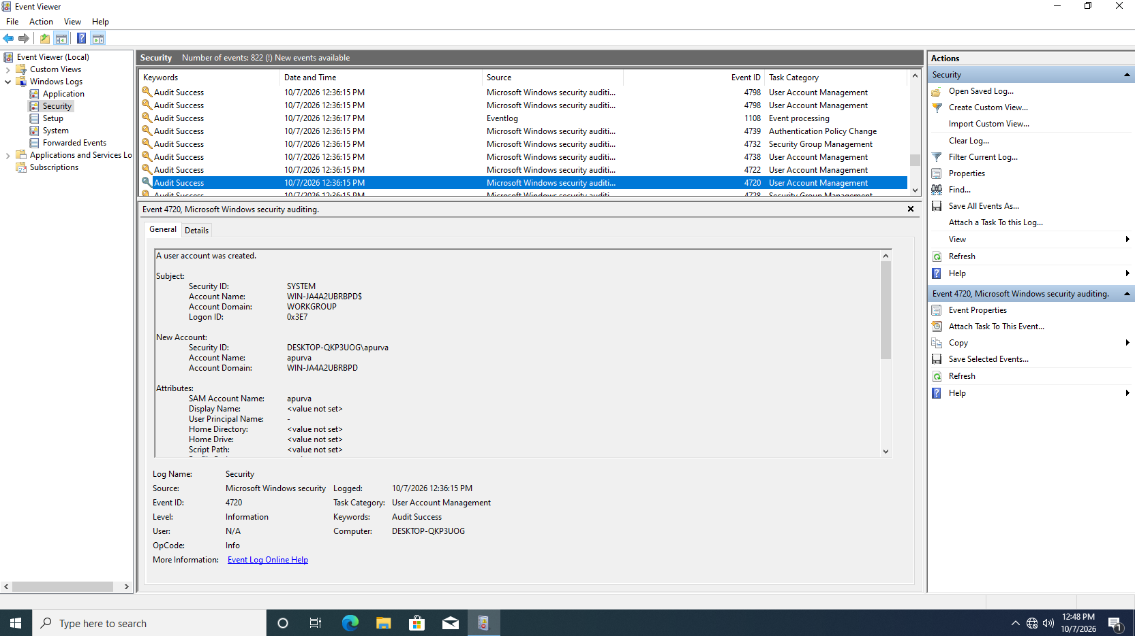
Event 4720: A user account was created
10/07/2026 12:36:15 PM | User Account Management | Audit Success
A new local user account 'apura' was created by the SYSTEM account (logon ID 0x3E7) - the normal identity when account management is triggered programmatically.
Field | Value
New Account Name | apura
New Account SID | DESKTOP-QKP3UOG\apura
New Account Domain | WIN-JAA2UBRBPD
SAM Account Name | apura
Display Name | <value not set>
Subject Account | SYSTEM (Logon ID 0x3E7)
The account domain reads WIN-JAA2UBRBPD while the computer field is DESKTOP-QKP3UOG - the creation record carries the original computer name.
DG Interns Hub | Week 1 - The Basics: Security and the SOC
23

Slide 24
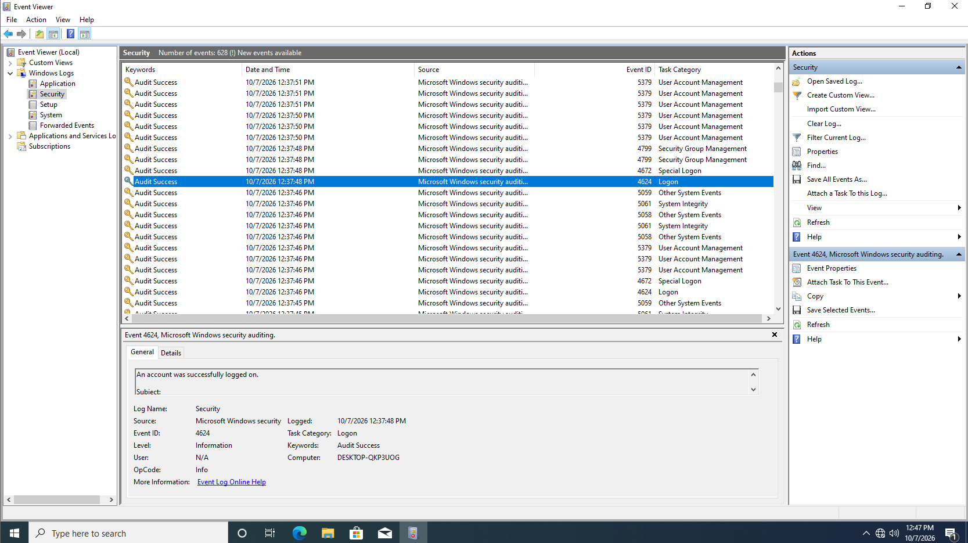
Event 4624: An account was successfully logged on
10/07/2026 12:37:48 PM | Logon | Audit Success
A successful logon was recorded about 90 seconds after the 'apura' account was created, indicating the new account was usable immediately.
Field | Value
Log Name | Security
Task Category | Logon
Level | Information
Keywords | Audit Success
Logged | 10/07/2026 12:37:48 PM
Computer | DESKTOP-QKP3UOG
The General tab is collapsed, so the New Logon SID list is not visible - expand it for full attribution.
DG Interns Hub | Week 1 - The Basics: Security and the SOC
24

Slide 25
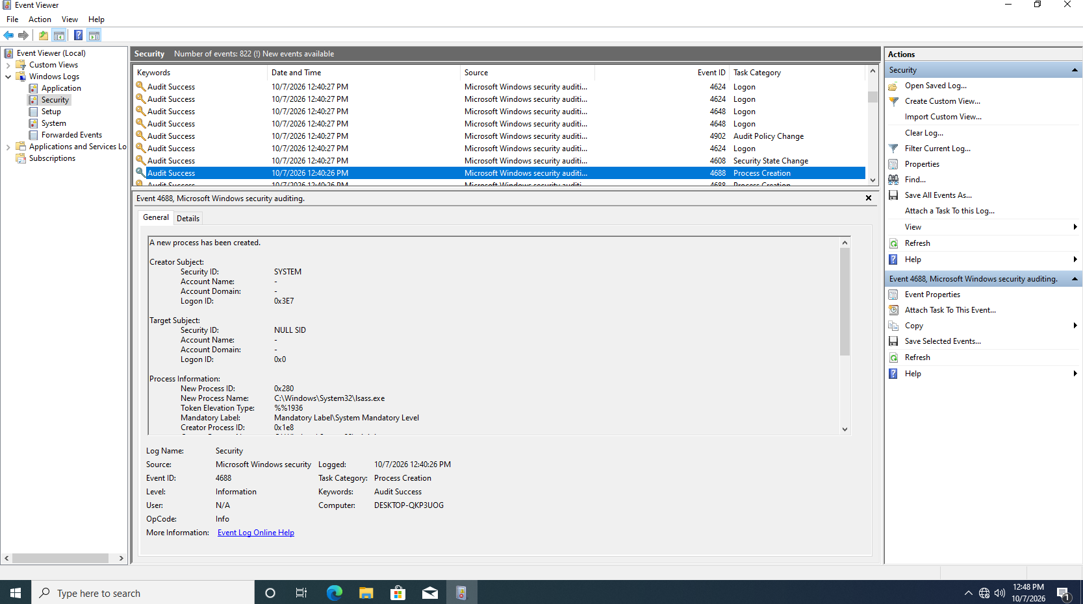
Event 4688: A new process has been created
10/07/2026 12:40:26 PM | Process Creation | Audit Success
Process creation auditing captured lsass.exe (the Local Security Authority Subsystem) - a normal Windows system process.
Field | Value
New Process Name | C:\Windows\System32\lsass.exe
New Process ID | 0x280
Creator Subject | SYSTEM (Logon ID 0x3E7)
Target Subject | NULL SID (Logon ID 0x0)
Token Elevation Type | %%1936 (TokenElevationTypeFull)
Creator Process ID | 0x1e8
Command-line logging is not shown - enabling it would record the full argument string.
DG Interns Hub | Week 1 - The Basics: Security and the SOC
25

Slide 26
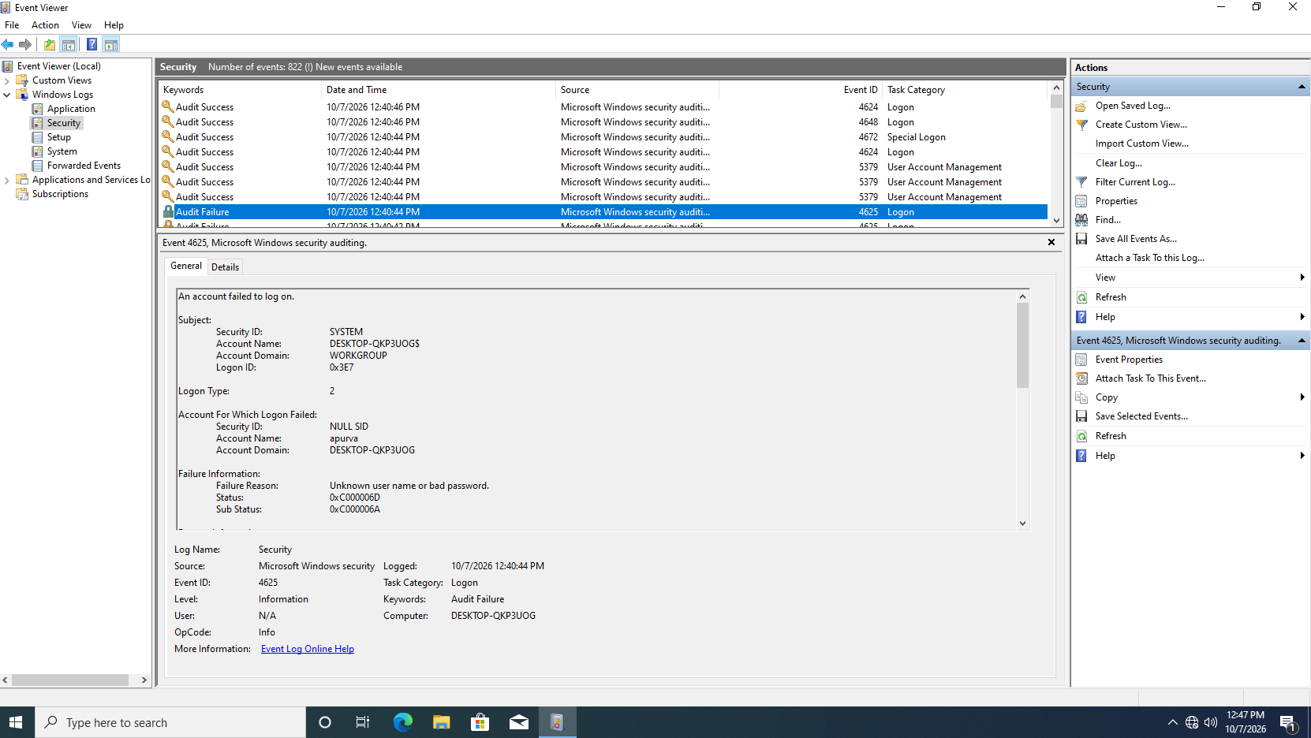
Event 4625: An account failed to log on
10/07/2026 12:40:44 PM | Logon | Audit Failure
An interactive (Type 2) logon for 'apura' failed because the user name or password was incorrect. The account carries a NULL SID - authentication never succeeded.
Field | Value
Account Name | apura
Account Domain | DESKTOP-QKP3UOG
Logon Type | 2 - Interactive
Account SID | NULL SID
Failure Reason | Unknown user name or bad password.
Status / Sub Status | 0xC000006D / 0xC000006A
Sub Status 0xC000006A means a bad password for an existing account (0xC0000064 would mean an unknown user name).
DG Interns Hub | Week 1 - The Basics: Security and the SOC
26

Slide 27
Correlation and Analysis
Turning four events into one timeline
Time | Event | What happened
12:36:15 PM | 4720 | Account 'apura' created by SYSTEM
12:37:48 PM | 4624 | Successful logon - the new account worked about 90s later
12:40:26 PM | 4688 | lsass.exe created - normal system process
12:40:44 PM | 4625 | Interactive logon for 'apura' failed - wrong password
Analysis
• Only one of the four events is a failure - Event 4625.
• Sub Status 0xC000006A means the account existed but the password was wrong (0xC0000064 would mean an unknown user name).
• The sequence matches normal account provisioning and testing, not malicious activity.
• In a production environment the single wrong-password failure would be worth a follow-up, and repeated failures would warrant a lockout or brute-force investigation.
DG Interns Hub | Week 1 - The Basics: Security and the SOC
27

Slide 28
Key Takeaways
What Week 1 established
• A SOC is people, process and technology working together to monitor, detect and respond.
• The L1/L2/L3 model shows how triage escalates into deeper investigation and detection engineering.
• The CIA Triad is the lens for judging the impact of any incident.
• Network models (OSI and TCP/IP) underpin how attackers and defenders see traffic.
• Phishing and malware remain the most common entry points - and the most preventable.
• Windows Event Viewer is the starting point for endpoint investigation on Windows hosts.
• Event IDs 4624, 4625, 4688 and 4720 answer who logged in, who failed, what ran, and who was created.
• Correlating events by time and host turns isolated log entries into a defensible narrative.
DG Interns Hub | Week 1 - The Basics: Security and the SOC
28

Slide 29
Deliverables and LinkedIn Activity
Everything produced in Week 1
Deliverable | File | Status
Notes folder | 6 documents (19 pages) | Complete
Writeups folder | 6 documents (75 pages) | Complete
Findings folder | 4 Event Viewer screenshots | Complete
PDF report of weekly work | Week 1 Report - Weekly Work.pdf | Complete
Presentation report | Week 1 Presentation - Weekly Work.pptx | Complete
Readme file | README.md | Complete
LinkedIn post 1 | What a SOC analyst does daily (5 points) | Drafted
LinkedIn post 2 | Week 1 experience, tagging DG Interns Hub | Drafted
LinkedIn post text is provided in 'LinkedIn Posts.md' and is ready to publish.
DG Interns Hub | Week 1 - The Basics: Security and the SOC
29

Slide 30
Thank You
Week 1 - The Basics: Security and the SOC
DG Interns Hub | SOC Analyst Internship | 07 October 2026

